Slide 1
Hydrological Information System
Module - Discharge Measurement using Doppler devices
Anish
….. Consultant, Hydro-Informatics
The World Bank

Slide 2
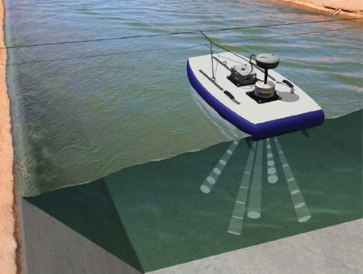
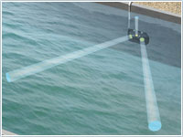
Acoustic Doppler Systems
Concept
  Acoustic Doppler systems rely on SONAR which uses sound waves to determine the distance to targets
  The Doppler Effect is used to resolve the velocity of flowing water by bouncing acoustic signals of a known frequency off backscatterers or targets in the water column and measuring the change in frequency of the return signal.
  Targets are generally sediment or organic materials in the water column that are moving at the same velocity and direction as the water.
Types
  Fixed
  Current Profilers

Slide 3
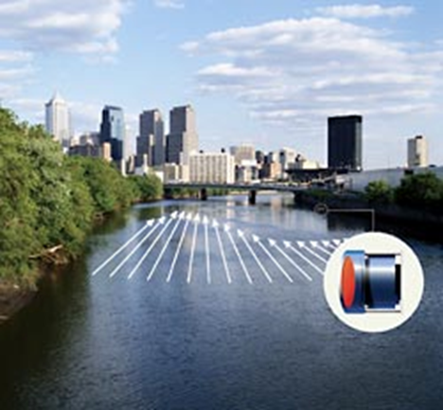
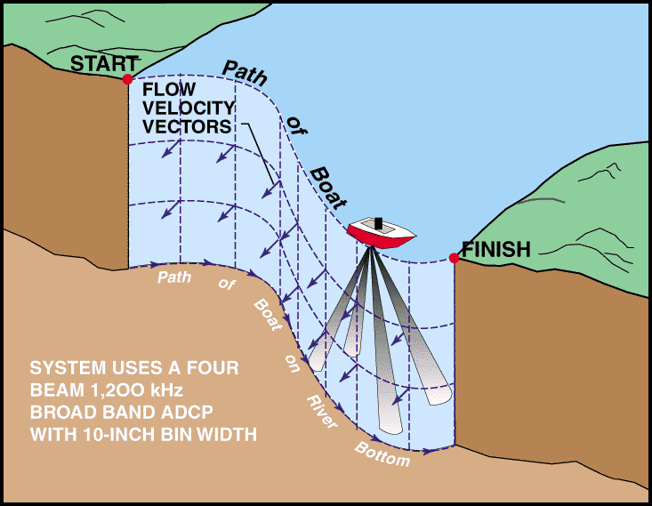
Acoustic Doppler Current Profilers (ADCP)
Acoustic Doppler Velocity Meters (ADVM)

Slide 4
ADVM - General Information
Well-suited for discharge measurements in canals with fixed channel geometry
Effective for monitoring discharge in tidally affected rivers or other unsteady flow reaches
ADVM’s can be a good alternative for streams where constant silting causes inaccuracy when using the traditional stage-discharge method.
Useful for acquiring detailed velocity data for model calibration.

Slide 5
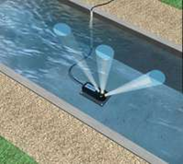
Upward Looking ADVM
ADVM is mounted to the bottom of the channel.
Channel shape is input into data logger for calculation of discharge.
Ideal Locations
  Canals where the water is generally free from sediment and debris
  Pipes or culverts flowing full or partially full

Slide 6
Side Looking ADVM
ADVM is mounted on or near one of the banks of a channel.
Velocity is calculated along beam paths and converted to average channel velocity using an “Index-Velocity” rating.
The cross-sectional geometry is surveyed and used to calculate discharge.
Ideal Location
  Typically deployed in an natural channel
    Reduces the chance for sediment covering the sensor
    Sensor mounted out of the way of highest velocities and potentially damaging debris

Slide 7
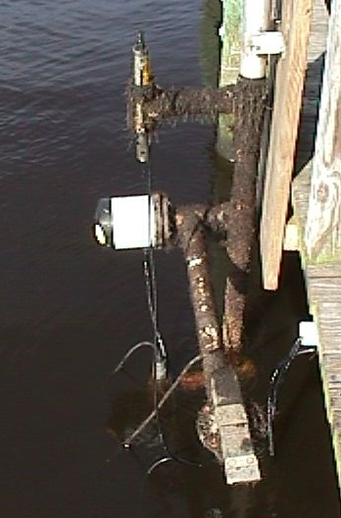
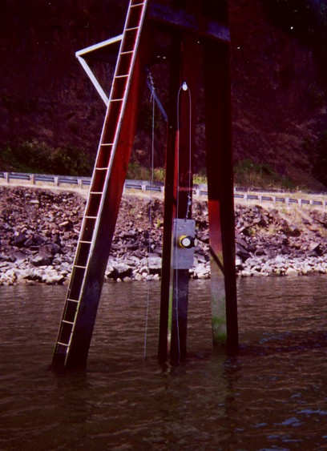
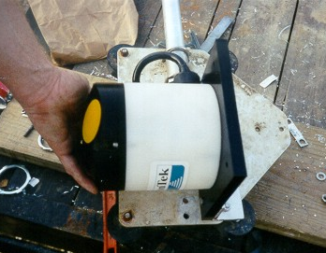
SonTek Argonaut SL
Notes:
Here are photos of the most common horizontal profiler – the SonTek Argonaut SL. The photo on the right shows a SonTek ADP SL at a gauge on the Columbia River in Oregon.

Slide 8
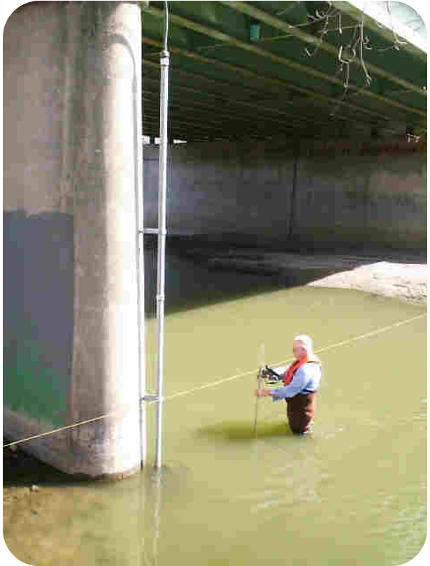
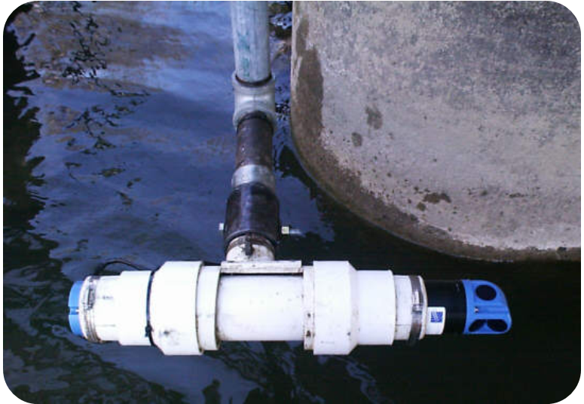
Nortek EZ-Q
Notes:
This is a Nortek EZ-Q mounted to a bridge pier in Indiana. It was mounted to the pier ‘facing’ towards the left bank. Do you notice anything odd or wrong about the discharge measurement being made in the photo on the right?
The streamgager is standing in the area that includes the sampling volume for the horizontal profiler.

Slide 9
Sontek Uplooker ADP
Notes:
This is a photo of a SonTek ADP uplooker that was used for some work in Florida. The ADP was direct-cabled to shore.

Slide 10
Sontek Argonaut SW
Notes:
Here is one of the newer profilers, the SonTek Argonaut SW. This profiler was originally designed for use in shallow canals and can be used to directly measure the flow. It is being used in several offices in the USGS as an index-velocity meter.

Slide 11
What Is an ADCP?
Acoustic
Sound
Waves and the
Doppler
Doppler
Shift are used to measure
Current
Water Velocity
Profiler
Profiles
Notes:
What is an ADCP?
First its acoustic, meaning that it uses sound to make its measurements.
It uses sound to measure velocity using the Doppler shift principle. Whether you realize it or not you are familiar with this principal. It is what changes the pitch of the horn on a passing car or train. A sound approaches you the sound waves or compressed and you hear a higher pitch. When the sound is moving away the sound waves or stretched an you hear a sound with a lower frequency.
Using this technology through water the ADCP measures the velocity of the water.
The ADCP measures profiles of water velocity, rather than sampling the water column at discrete points.

Slide 12
ADCP (Current Profiler)
Used for making instantaneous discharge measurements in lieu of standard mechanical meters using cups or propellers
Usually attached to a motorized boat or towed flotation device

Slide 13
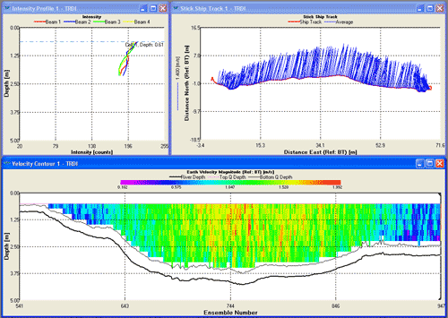
ADCP Discharge Measurement
Computes discharge on-the-fly
Provides complete velocity structure and channel geometry for model input

Slide 14
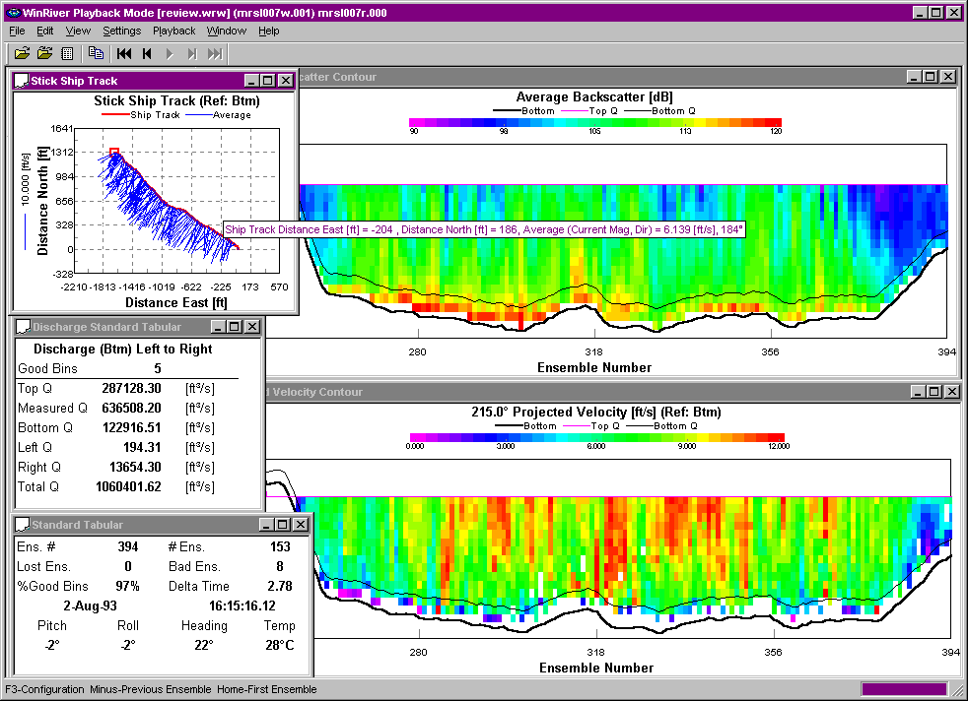
High Flow - Mississippi River
Notes:
Here is a high flow discharge measurement that was made at St. Louis during the 1993 Mississippi River Flood. This transect took less than 10 minutes to make and the measured discharge was > 1 million cubic feet per second. Even 4 passes (as required by OSW policy) would have only taken 30-40 minutes, not counting boat launch and retrieval. In comparison, Price AA measurements made near the gage from the Poplar Street bridge required 4-6 hours.
ADCP’s are great tools for making high flow discharge measurements and allow for significant improvement in efficiency. The Indiana District reported that they were able to make approximately 50 measurements in a 1-week period during a flood event in July 2003.

Slide 15
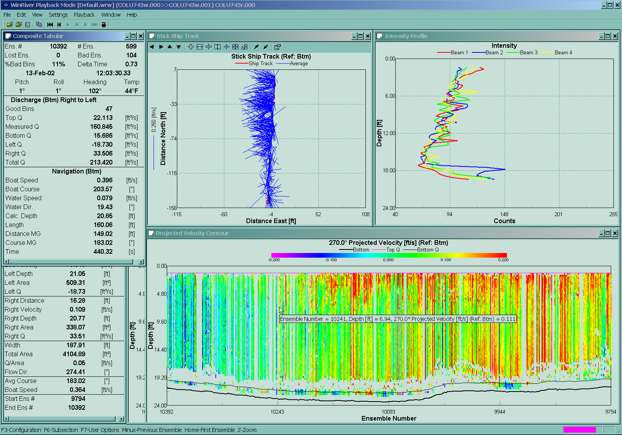
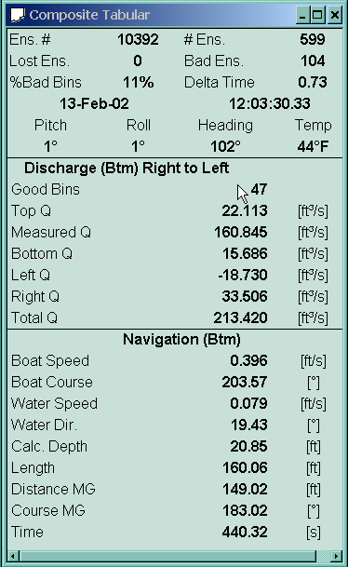
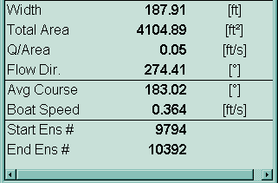
Low Flow Measurements
Mean Velocity = 0.05 ft/s
Notes:
This slide illustrates a discharge measurement of a very low flow – where the mean velocity was 0.05 ft/s ( xx cm/s ). This measurement was made in the Chicago River, where the cross sectional area is in excess of 4,000 square feet.

Slide 16
Terminology
Pings
Acoustic pulses of a known frequency
Depth Cells (Bin)
A segment of a velocity profile, similar to a point velocity measurement
Ensembles
A collection of 1 or more pings averaged together to obtain a water velocity profile and/or a boat velocity at a single point
Transect
A group of ensembles collected while traversing a stream that constitute a single measurement of discharge
Bottom tracking
Acoustic method used to measure boat speed and direction. Typically, the depth is also measured during bottom tracking.
Notes:
Terminology
Lets review some of the terminology that we will be using in this class.

Slide 17
What are ADCPs being used for?
Measurement of Streamflow
Measurement of Velocity Fields
  Modeling studies
  Hydraulic studies (for example, safety zones near dams)
Hydrographic Surveys (channel bathymetry)
Estimation of Sediment Concentration from Acoustic Backscatter (ABS)?
Notes:
What are ADCP’s being used for?
ADCP’s are used in variety of applications including:
Measurement of Streamflow
Measurement of Velocity Fields
Modeling studies
Hydraulic studies (for example safety zones near dams)
Hydrographic Surveys (channel bathymetry)
Estimation of Sediment Concentration from Acoustic Backscatter (ABS)?

Slide 18
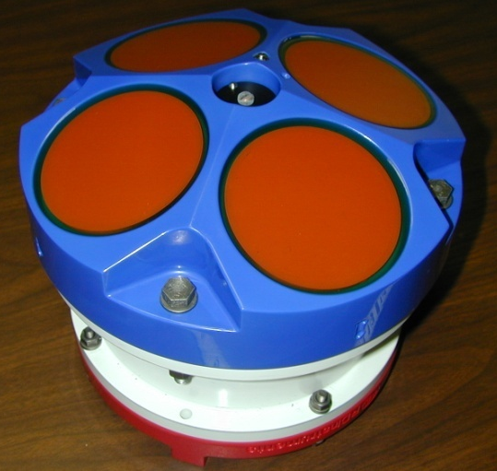
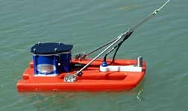
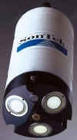
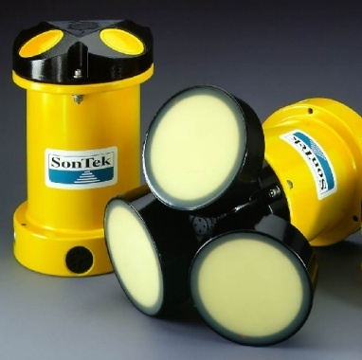
Some Commonly Used ADCPs
RDI StreamPro
RDI Rio Grande ADCP
SonTek Mini-ADP
SonTek ADP
Notes:
Here are some of the commonly used ADCP’s. One ADCP not shown is the Boogiedopp ADCP. The future of the Boogiedopp is somewhat ‘up in the air’ at present, although there are approximately 10 in use in the USGS.

Slide 19
Acoustic Doppler Systems: Advantages/Disadvantages
Advantages
  Measures discharge in a wide variety of unsteady flow situations and where no stage-discharge relation exists
  Ideally suited for estuaries and canals
  Instantaneous Discharge
  Saves time over conventional measurements saving time and improving safety
  Potential application in sediment monitoring and bathymetric surveys
Disadvantages
  Complexity (requires significant and ongoing training)
  Costs are high but coming down

Slide 20
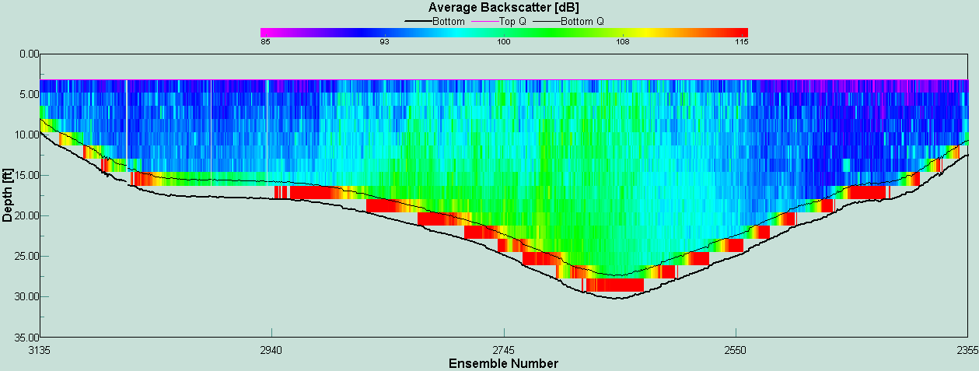
Using Acoustic Backscatter as a Surrogate of Sediment Concentration
Notes:
Another example of use of uplookers is from New York where an uplooker is being used to estimate suspended sediment loads on the Hudson River. Shown here is a backscatter contour plot from WinRiver. The question is, Can we use acoustic backscatter (ABS) as a surrogate for suspended sediment concentration? When one studies backscatter contour plots such as this one, it seems possible, at least qualitatively.

Slide 21
ADCP – Additional Applications
Calibration of ADVM instruments and curves
Measurement of suspended sediments
Measurement of Bed profile and bathymetry survey
Velocity Vectors for detailed flow direction analysis

Slide 22
Index-Velocity Ratings
Notes:
ADCPs are also used to develop index velocity ratings such as the one shown here. At this site, prior to usage of the ADCP, no measurements were possible for velocities ranging from about 1.5 ft/s to 4.00 ft/s, due to the rapidly changing flow conditions and the time required to make a Price AA measurement. The measurements ranging from 2.4 to 3.2 ft/s (red dots) provided definition of the rating that was unavailable using conventional methods.

Slide 23
Can ABS be used to Estimate Sediment Loads?
Notes:
Another example of use of uplookers is from New York where an uplooker is being used to estimate suspended sediment loads on the Hudson River. Shown here is a backscatter contour plot from WinRiver. The question is, Can we use acoustic backscatter (ABS) as a surrogate for suspended sediment concentration? When one studies backscatter contour plots such as this one, it seems possible, at least qualitatively.

Slide 24
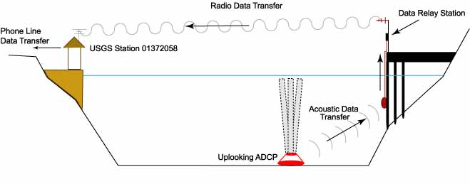
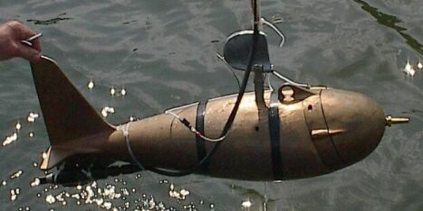
Uplooker Data Collection System
Hudson River near Poughkeepsie, NY
Notes:
Liz Nystrom and Gary Wall have installed an RDI Workshorse on the bottom of the Hudson River near Poughkeepsie, NY. Data from the profiler are transmitted to the nearest shore by means of an acoustic modem. Then an SDI-12 data radio transmits the data across the river to the gaging station, where it can be transmitted to the office. Periodically, sediment cross-section measurements are made, and profiles of sediment concentrations are obtained using a point sampler such as that shown here. The suspended sediment data are then correlated with ABS.

Slide 25
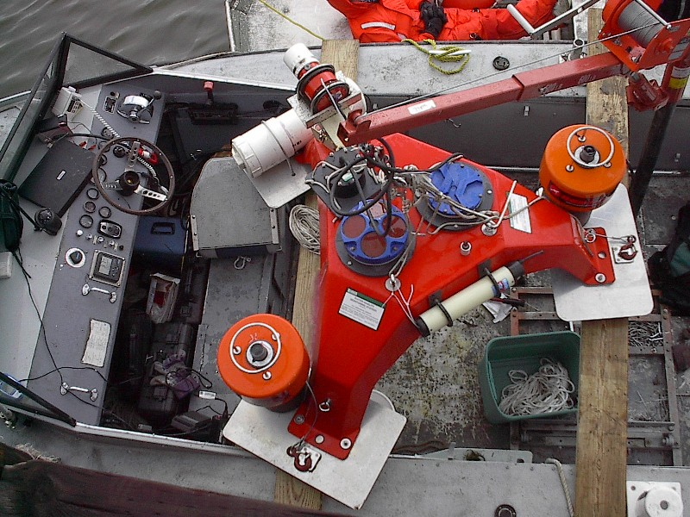
Equipment Tripod
Acoustic
Modem
Battery pack
& ADCP
OBS
Sensor
Acoustic
Release
Notes:
This photo shows the equipment tripod that is used to collect data on the Hudson River. It includes the ADCP and its battery pack in the center, along with an optical backscatter sensor (OBS), an acoustic modem for transmitting data to shore, and dual acoustic releases. These latter can be triggered by a special acoustic signal from a boat and a buoy and line are released and pop to the surface. Then the ADCP and the tripod can be retrieved.

Slide 26
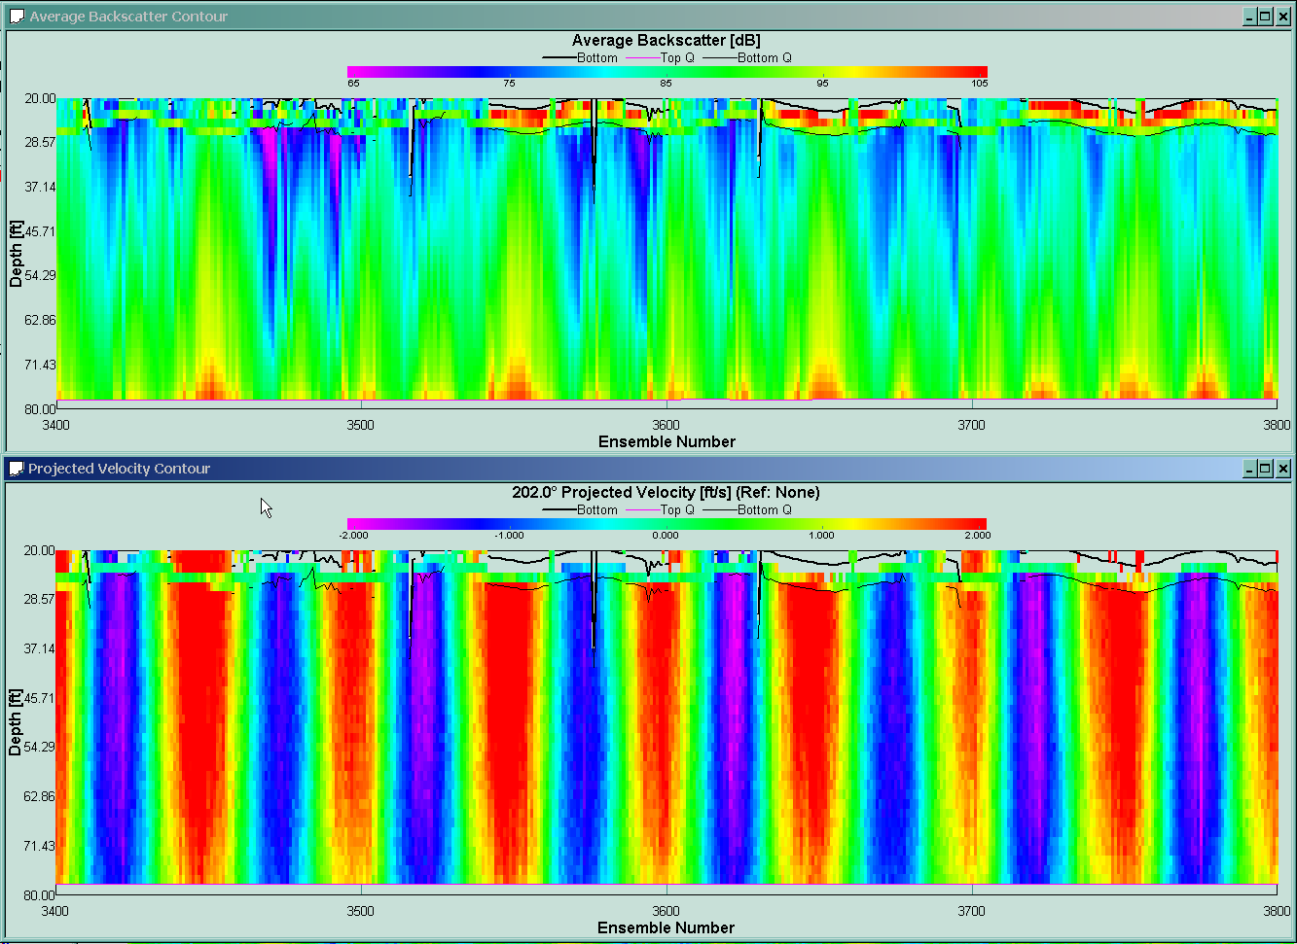
Acoustic Backscatter and Velocity
Backscatter
Velocity
Notes:
Here are some preliminary results showing velocity and backscatter measurements made over a number of tidal cycles. You can see the increase in backscatter that corresponds to the increase in the velocities.

Slide 27
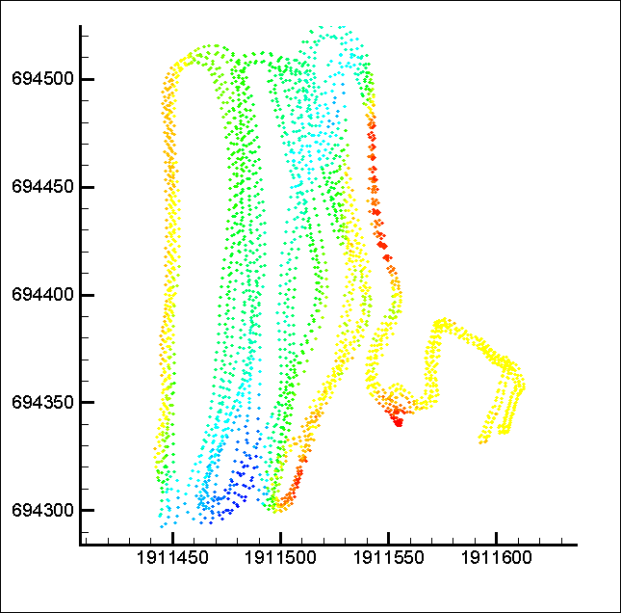
Use of Individual Beams for Bathymetry
Two tracks
Notes:
Randal’s macros allow all depths and locations for all four beams to be computed and used for make a map of the bathymetry. Here, for every ensemble, 4 beam depths were obtained. The beam depths are color coded based on the depth, with blues indicating deeper depths and yellows shallower depths.

Slide 28
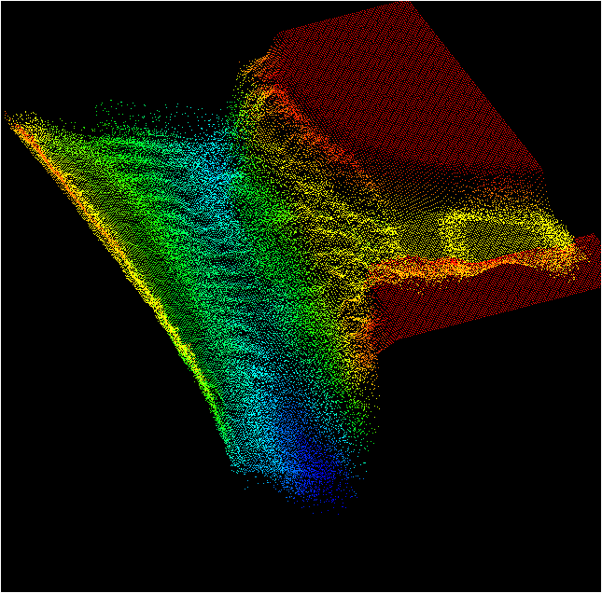
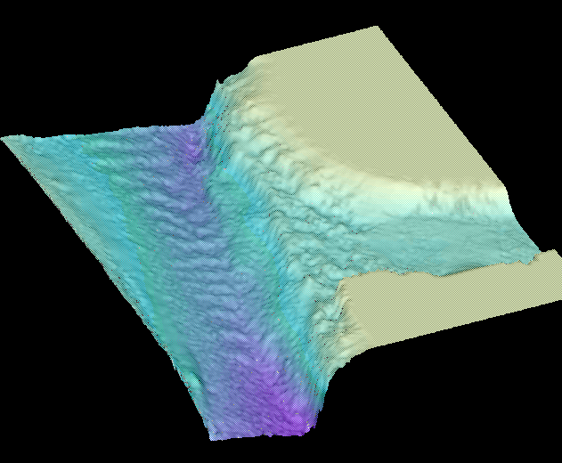
Generation of Map
Interpolation of bed elevations to x-y-z grid
Surface
Shading of
x-y-x grid
Notes:
Using 60 transects in this area, and the beam depths obtained from these measurements, a 3-D surface of the bed can be created as shown here.
Do you notice any interesting features regarding the bed?
The bathymetry from the ADCP is good enough to resolve dunes in the Sacramento River (running roughly from the top left to the bottom center of the map.

Slide 29
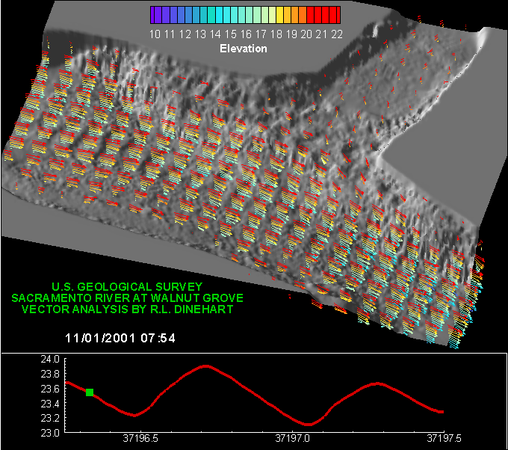
Velocity Vector Animation
Notes:
Randal then extracted the velocity data for those same 60 transects (over 2 tidal cycles). He imported them into a program called TecPlot and developed an algorithm for interpolating the velocity data at each location on to a regularly spaced grid. This shows an animation of the velocity field over 2 tidal cycles. The colors of the vectors correspond to the elevation (or depth) associated with each vector. Notice the exchange that takes place between the Sacramento River and the Delta Cross Channel. Notice how flow actually reverses and goes upstream and into the Delta Cross Channel.

Slide 30
Instrument Considerations

Slide 31
Accuracy and Precision
  Sensor accuracy
  Resolution
  Range
  Drift
  Clock accuracy
  Response time
  QA testing (trust but verify)

Slide 32
Technical
  Power requirements
  Input/Output connections
    Type
    Number
  Memory protection
  Surge protection
  Data storage capacity
  Data handling (fill and stop or write over)
  Software and firmware
  Programming interface (display, PC, tablet)

Slide 33
Environmental
  Operating range for temperature and humidity
  Thermal and mechanical shock (transportation, storage, and deployment)
  Vibration
  Solar radiation
  Wind
  Sand and dust
  Ice
  Corrosion
  Build quality (internal and external)
  Regulatory compliance (frequency, signal strength, FCC approval)

Slide 34
Operational
  Maintenance requirements
  Complexity
    Installation
    Programming
    Calibration
  Expandability

Slide 35
Procurement
  Specifications
    Too few can result in unacceptable products
    Too many can cost more and miss a good solution.
  Warranty
  Vendor support (technical and warranty)
  Cost

Slide 36
Cost Table (Approximate)
Item | Cost (INR)
Shaft Encoder | 60,000
Bubbler | 180,000
Pressure Transducer | 60,000
ADCP | 1,200,000
ADVM | 300,000
Ultrasonic Sensor | 90,000
Radar Sensor | 180,000
Data Logger | 120,000

Slide 37
Questions/Comments?

